Slide 1
TensorFlow - Basics

Slide 2
What is TensorFlow?
Numerical computation library, well suited for various machine learning tasks (especially deep learning)
The basic workflow is to define a computational graph using the python API and then pass data through the graph
Low-level of abstraction, can manipulate every small detail of the computational graph
Contains high-level abstractions to speed up experimentation for off-the-shelf methodologies
tf.learn, tf.slim, tf.keras

Slide 3
Using TensorFlow
TensorFlow programs have two sections, defining the graph and running the graph
TensorFlow uses computational graphs under the hood to run the functions and models
The graphs are defined by their operations and operands as the edges and nodes
Defining the operations and operands will not run the graph when the TF code is evaluated
Instead it assigns those variables and operations to the graph to be run later
TF Sessions are used to run the graphs once everything is set up
They create a connection between the Python API and the C++ runtime
Sessions can run graphs on either a CPU or GPU

Slide 4
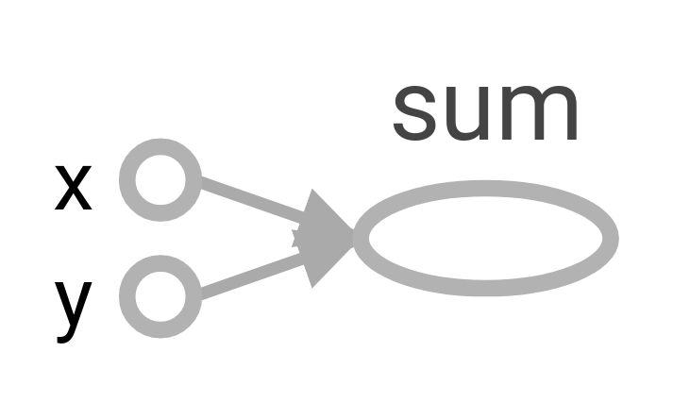
Defining a Simple Graph
We want to add 7 to 9
x = tf.constant(7, name=”x”)
y = tf.constant(9, name=”y”)
z = tf.add(x, y, name=”Sum”)
Notes:
The name parameter assigns a name to the particular variable or computation in the graph.
On the right is a diagram of the specified graph with the assigned names.
Can evaluate z with tf.add or just x + y

Slide 5
Running a Simple Graph
Actually run the graph and get a value.
Will run the function z and assign the value to result.
with tf.Session() as sess:
result = sess.run(z)
# result will be 16

Slide 6
Placeholders
We are typically using TF for machine learning problems so it doesn’t make sense to have our data as part of the computational graph
Instead we want to create buckets that we can feed data into, then have the graph give us some output based on the data and the defined computations
Tf.placeholder allows us to define these buckets by specifying the expected shape and datatype of the data that will flow through our graphs
What matters for placholders:
data type (first arg)
shape (second arg)
Notes:
placeholders are there tpo build a graph, saying what will go into it and what operations to be performed on it

Slide 7
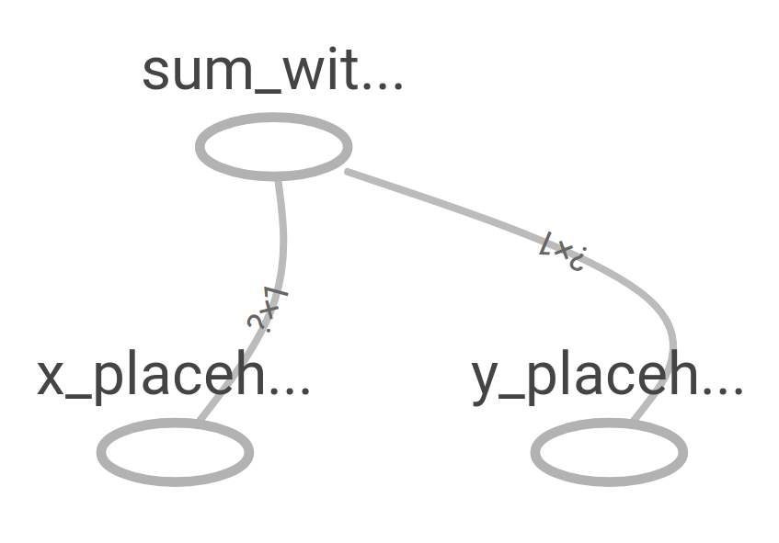
Placeholders
Setting up a vectorized version of our addition graph with tf.placeholder
x = tf.placeholder(tf.int32, shape=(None, 1), name=”x_placeholder”)
y = tf.placeholder(tf.int32, shape=(None, 1), name=”y_placeholder”)
Z = tf.add(x, y, name=”sum_with_placeholders”) # element-wise add
Notes:
The None means that we can pass any number of 1-dimensional vectors to be added together. We will see this a lot when we do mini-batch gradient descent when training neural networks.
If you created two random vectors in numpy of length 10 each, this operation would add them together elementwise.

Slide 8
Placeholders - running the graph
Using a Session to run a graph with placeholders allows us to pass whatever values we want into the graph as long as it meets the shape and data type specifications.
The feed_dict parameter allows us to specify which bucket we want to place which data when we run the graph
x_np = np.random.randint(10, size=(3,1))
y_np = np.random.randint(10, size=(3,1))
with tf.Session() as sess:
result = sess.run(z, feed_dict={x:x_np, y:y_np})
Notes:
Might be a question on the numpy shapes. The 3 corresponds to the None on placeholder init. The 1s correspond to each other. So we are adding three values together, each held in a 1-dim vector. It’s called TensorFlow afterall so everything has to be inside of a Tensor, doesn’t really do well with naked scalars.

Slide 9
Learning with TensorFlow
When it comes to learning what we usually mean is updating some weight matrices so that they output the values we desire when they are multiplied by some data.
To create matrices that have values that can be manipulated we use tf.Variable.
We will then define the shape and initialization method for these values
TF will take care of updating the weights as specified by the solvers or optimization algorithms that we choose to work with.
Notes:
initialization = how to seed weights

Slide 10
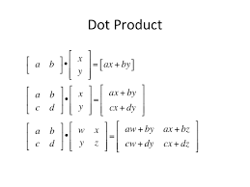
Learning with TensorFlow - linear regression
Say we are trying to estimate house prices using two features, number of bedrooms and number of bathrooms
X = tf.placeholder(tf.float32, shape=(None, 2), name=”house_features”)
Y = tf.placeholder(tf.float32, shape=(None, 1), name=”house_price”)
W = tf.Variable(tf.ones([2, 1])
Y_hat = tf.matmul(X, W) # dot product
Notes:
Weight matrix has size (num_features, 1), we want a single output (house price) given the two features.

Slide 11
Learning with TensorFlow - linear regression
We will use gradient descent to find the best weights for our problem.
Minimizing mean squared error
All operations that are added, TF keeps track of them and how they are chained together.
error = y_hat - y # is actual labels/prices
loss = tf.reduce_mean(tf.square(error), name=”MSE”)
training_step = tf.train.GradientDescentOptimizer(learning_rate=0.01).minimize(loss)
Notes:
Gradient descent obviously isn’t the best way to do linear regression, but people typically use TF for deep learning and not linreg. So if they really wanted to do this right they’d use sklearn and a better linear solver.
You’ll pretty much use some form of Grad Desc for all NN problems in TF so we’ll stick with that here.
https://www.tensorflow.org/api_docs/python/tf/reduce_mean
All operations that are added, TF keeps track of them and how they are chained together.

Slide 12
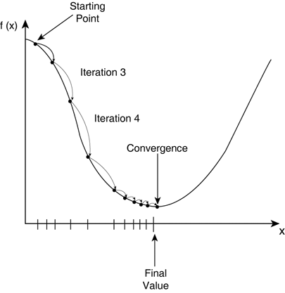

How to train a network?
Almost every deep learning model is trained by an algorithm called Stochastic Gradient Descent.
t(k) - true value of data point k
a(k) = activation of the network of data point k (in this case lin reg.)
F(K) = squared error
Notes:
Nearly every single deep learning model is trained by a process called Stochastic Gradient Descent.
If you were to plot the loss function against possible weight values it would look something like this. The weight values that give us the lowest cost are the ones that we want to go for.
Most machine learning problems have a cost function, which measure how bad the model did at the task. We want to minimize the values of this function.
Instead what we do is approximate the gradient with a small number of examples chosen randomly from the dataset. Hence the name, stochastic gradient
For each data pair k, we calculate the difference between target and given output then square that (squared error).
So then we use that error term and calculate the partial derivative of that error w.r.t. each weight.
Finally, we update each weight in the direction of the negative gradient. We want to move in the opposite direction of the gradient value.

Slide 13
Learning with TensorFlow - linear regression
With gradient descent, training is done iteratively with the training_step object that we created
EPOCHS = 10
with tf.Session() as sess:
for e in range(EPOCHS): # EPOCHS = iterations
sess.run(training_step, feed_dict={X:house_feats, y:house_prices})
Notes:
remember, x and y are the place holders we defined

Slide 14

Backpropagation
The process to updating the weights with each stochastic gradient calculation is called backpropagation. (f(x) = f(K))
When we make predictions or outputs from the network we feed the data forward through these functions.
To update the weights we just go backwards through each functions and take the derivatives along the way. It’s basically an exercise in the chain rule of calculus.
Notes:
So we know that we want to go in the opposite direction of the gradient, but how do we get there? Backpropagation
In the equation at the bottom we can see that we are basically, expanding each function into the terms that comprise it.
That is basically what we do in backpropagation, we keep moving backward through the equations and expand them at every step.
When using a feed forward neural network the data flows through the composed functions one by one.
The output of each function becomes the input to the next.

Slide 15
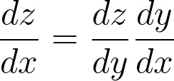
Backpropagation
Let's say we have have functions y = g(x) and z = f(g(x)) = f(y). To find the derivative of z w.r.t. to x we have to move through the intermediate function y.
If you are familiar with the chain rule for finding derivatives, then you can think of backpropagation as an application of the chain rule.
Notes:
triaining step is one step of backproagation through the whole network
We already said that we have a way to evaluate the network for every input and output pair.
And we have a way to tell which direction to update the weights in order to minimize this error
What we need now is a way to get the error signal to each layer of the network.
So far the only thing that we can do is get the gradient w.r.t the last layer.
What we are going to do is essentially expand each function into it’s components.
Lets say that we have the functions y = g(x) and z = f(g(x)) = f(y).
To get the gradient to x we from the top function we have to move through the intermediate function.
If you are familiar with the chain rule of calculus, we are just doing that all the way down to the input.

Slide 16
Deep Learning

Slide 17
Deep Learning
We typically think of deep learning as neural networks but with the twist that we use many more layers of computation than were used when they were proposed.
We think of deep learning models as being comprised of layers into a chain of computation.
Which makes the graph structure of TensorFlow a perfect vessel for creating and using deep learning models.
A layer is typically a group of elementary operations running in parallel on some data
The output of a layer becomes the input for the following layer

Slide 18
What is deep learning?
Basically, it’s a rebranding of neural networks.
Notes:
The function of a neural network is to basically receive an input, perform a series of calculations on that input, and then provide an output.
This is an example of a pretty typical neural network the two yellow circles will take the input, the middle blue circles will transform that input, and the last circle will give us the output.

Slide 19
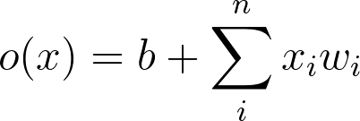
Starting simple
The first neural network was basically a single mathematical function that was inspired by biological neurons.
b₁
x₁
w₁
o(x)
x₂
w₂
Notes:
Looks exactly like linear regression
The first neural network was inspired by biological neurons.
Often attributed to people like, McCulloch and Pitts, and Widrow and Hoff.
It takes the input data, often represented as a vector, then multiplies each element of the input data by a corresponding weight. Then we sum all of those together with a bias term.
If someone has a question about the bias, if we think about linear regression or fitting a line of best fit. Without the bias we always have to start our line from the origin. The bias allows us more flexibility in the ways to fit to our data.
We call the output of that calculate the preactivation. Denoted here by o(x).

Slide 20
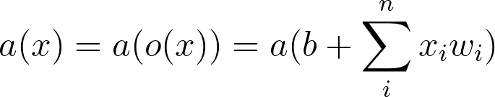
Starting simple
We typically apply a function to the output of that weighted sum
b₁
x₁
w₁
o(x)
a(x)
x₂
w₂
Notes:
The thing that I want to illustrate with the equation is that the outputs composed. So the output of a previous function because the input to the following.
After we get the preactivation it’s usually a good idea to apply a function on top of that preactivation output. We call this a nonlinearity or activation function.
The reason that we call it a nonlinearity, is that if we chain together a few neurons without these functions in between the resulting mathematical function ends up just being a big linear function of matrix multiplies.
These linear functions can do interesting things to some input data but it’s not enough to unlock the power of deep learning. We will get some intuition about why later.

Slide 21
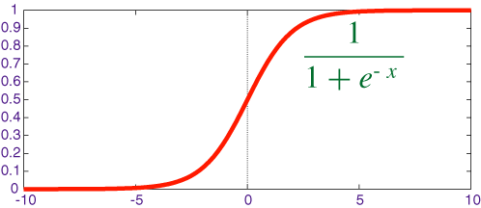
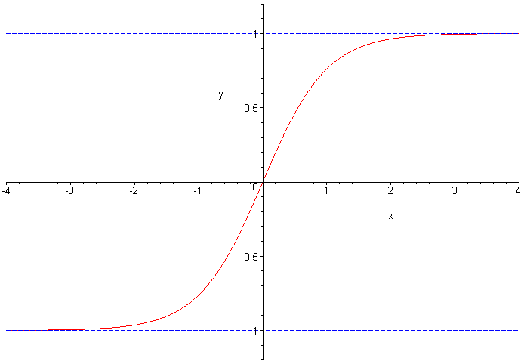
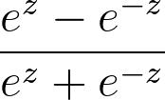
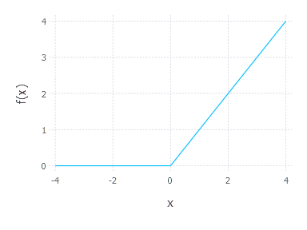
Activation Functions
Sigmoid Function - popular in the past but has fallen out of favor
Tanh Function - similar to sigmoid except has the benefit of being centered on 0, still common in RNN
Rectified Linear Unit (ReLU) - Most common activation function now. It’s simply max(x, 0)
Notes:
Activation Functions
Sigmoid - The first neural networks were simply functions that wanted to output 1 for on or 0 for off. They were inspired by biological neurons which only fired if they were activated or did nothing, hence the 1 or 0.
However the drawback was that it was tough to train them because the output was nondifferentiable. It’s not a very easy function to do math on.
So then people figured out that a sigmoid function was pretty similar to being an on/off function and it’s well behaved. It saturates at either 0 or 1
TanH - very similar to sigmoid except that the saturation points are at -1 and 1.
It has the added benefit of being centered on 0. This avoids some of the problem of the gradients being saturated in the flat spots.
There are good technical reasons for using tanh over sigmoid in ‘Efficient Backprop’ by Yann LeCun but since tanh themselves have fallen out of favor it’s worth spending a lot of time on here.
ReLU - currently the most popular activation function.
It’s basically linear in activation unless the preactivation falls below 0, then it outputs 0.
In 2012 when Alex Krizhevsky won ImageNet by a huge margin with a convolutional neural network he also showed that using ReLU he could train networks 6 times faster with equivalent accuracy.
Since then, it’s pretty much what everyone has been using. There are some alternatives to ReLU that sometimes perform a little bit better. But ReLU is pretty much the standard.

Slide 22
Is it useful?
Let’s say that we have three functions f⁽¹⁾,f⁽²⁾, and f⁽³⁾ all chained together.
The length of this chain is what we refer to as the depth of the network.
The chaining of these linear combinations turns out to be a very powerful idea. It allows the network to create meaningful abstractions and representations.
Notes:
If it useful?
These examples so far are pretty simple. Hardly considered deep.
What we do to make a deep learning model is combine a bunch of these small linear units together.
f⁽¹⁾ is the first function that takes the input data
f⁽²⁾ is the second function that takes the output of the first as it’s input
f⁽³⁾ is the third, which takes the output of the second as it’s input
Each function could have the same form as the linear unit that we saw before, a linear combination of weights with a nonlinearity applied on top.
The length of this chain is what we refer to as the depth of the network.
Only the first network has direct access to the input data, and only the desired output of the last layer is specified by the training data. Therefore we typically call all of the intermediate layers the hidden layers.
Those layers will be the ones responsible for finding the best representation of the data for the last layer to make its predictions from.

Slide 23
What is deep learning?
So if we want to put the previous simple neurons to form a more interesting neural network, we can combine (network) them as below.
Except with more weights. Putting more layers together, the input to each successive node is the output from the previous node.
W_{ij}
y₁
x₁
y₂
x₂
y₃
Notes:
The input to each layer is the output of the previous layer.

Slide 24
Deep Learning with TF

Slide 25
Deep Learning with TF
Developing neural networks with TF is flexible with various levels of abstraction
It’s common to define generic layers for a network that can be reused to initialize different parts of a network with different parameters
Once defined, the network can be trained by one of the gradient descent methods provided by TensorFlow

Slide 26
Defining a Layer
Define a generic layer with a function to construct the layer within the tensorflow graph.
def dense_layer(X, n_inputs, n_units, name, activation=None):
with tf.name_scope(name):
init = tf.truncated_normal((n_inputs, n_units), stddev=0.1)
W = tf.Variable(init, name=”hidden_weights”)
b = tf.Variable(tf.zeros([n_units]), name=”bias”)
z = tf.matmul(X, W) + b
if activation is not None:
return activation(z)
else:
return z
Notes:
We’ll create a function that we can pass arguments to in order to create neural network layers of different sizes and with different behaviors. We can use this same function to create every layer in our network.

Slide 27
Defining the network
Use the layer function to build a neural network
with tf.name_scope(“dnn”):
hidden = dense_layer(X, n_input=2, n_units=3,
name=”hidden”, activation=tf.nn.relu)
y_hat = dense_layer(hidden, n_input=3, n_units=1,
name=”output”, activation=None)
Notes:
build what we see there

Slide 28
Convolutional Neural Networks

Slide 29
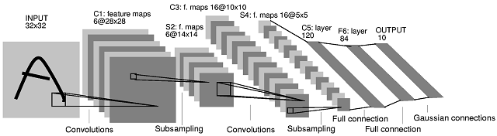
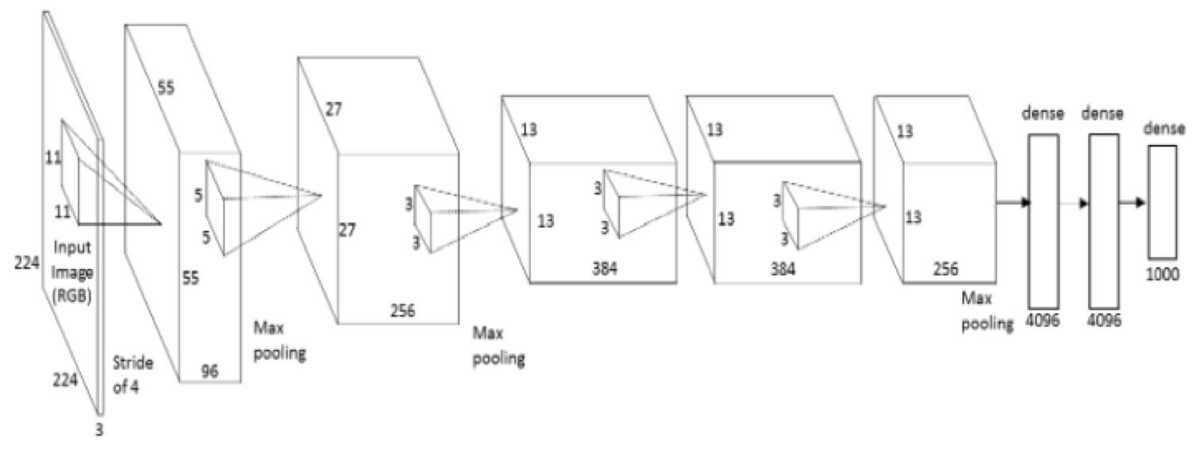
ConvNets
Convolutional Neural Networks (ConvNets) are a special type of feedforward neural network that are particularly well suited for data which contain some kind of spatial structure.
Notes:
o Intro ♣ ConvNets are a specialized type of neural network for processing data that has a known gridlike topology. • Some examples could include: o Time series data – think of a 1D grid, things in order have a relation to each other, previous time-steps have a direct impact on neighboring time points. o Image – 2D grid, pixels near each other are usually related, whether all those pixels belong to the same object, or objects are nearby each other for some reason. o Even text, it’s like a special case of timeseries, words that are close together are typically related. • Basically, they can be used for any type of data in which nearby data points are related in some way.

Slide 30
ConvNets
Instead of using a simple linear model for each node a ConvNet will use kernels that are applied to data.
Each kernel has their own weights and biases just like the normal types of layers that we looked at earlier.
Notes:
Very simple architecture that takes the representation learning idea and tweaks it so that the representations learned are more appropriate for certain data types.
The major differences are in the way that the weights are applied.

Slide 31
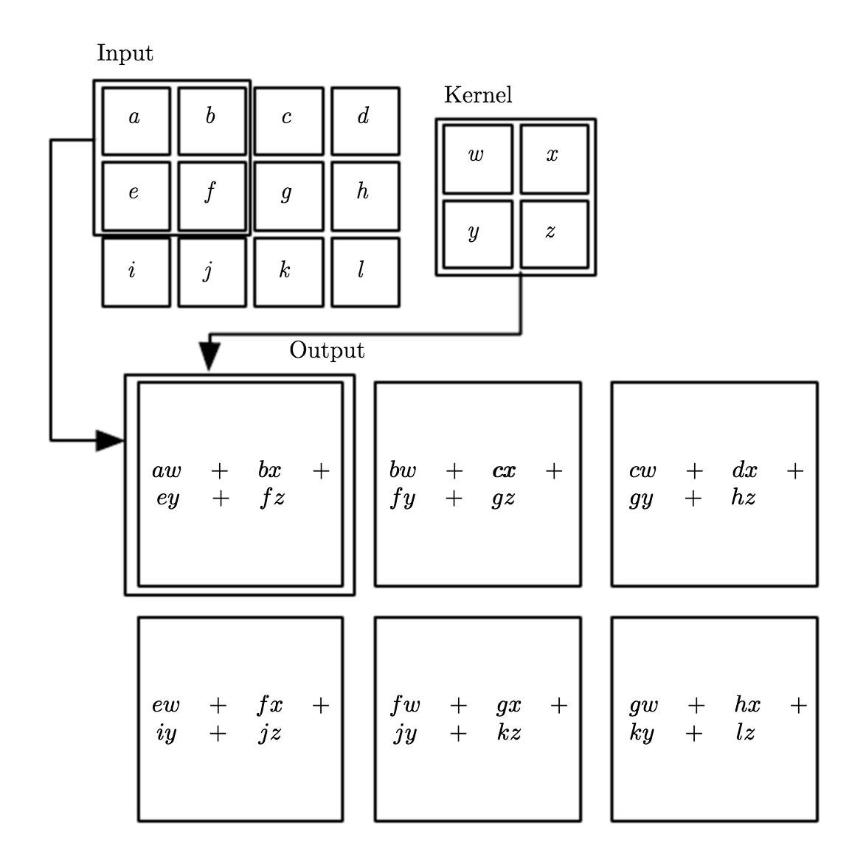
ConvNets
The kernels are applied like a sliding window along the input data.
The output of that operation will be the sum of each kernel weight multiplied by each corresponding input data point.
Notes:
In this example that data is 2D, like an image.
The weights in the kernel are multiplied to the data in the corresponding position, keeping the spatial information intact.

Slide 32
ConvNets
A single number is the output for each unique position that the kernel can occupy.
In this example, sliding a 2x2 kernel over a 3x4 matrix results in a new 2x3 matrix.
We call that new 2x3 matrix a feature map and it can then become the input to a following kernel.
Notes:
o This is where we get the idea of sparse connectivity and parameter sharing. ♣ In our image here our kernel has four weights. ♣ A normal neural network would have one connection between every input data point and every weight. • We’d set those up as two matrix multiplies. 3x4 input into a 4xsomething weight matrix. • If we wanted six outputs we’d have to set up the weight matrix to be 4x2. So we’d have twice the number of weights. • That wasn’t necessarily the best way to think about it. But it should help with the intuition. ♣ Parameter sharing is the idea that we can use the same weight value multiple times in our entire calculation. • In a typical neural network each weight value is tied to its input value and only that value. ♣ This kind of seems like a limitation at first, it feels like we severely crippling the capacity of our network. ♣ But we will see later that this turns out to be a great thing.

Slide 33
ConvNets
http://deeplearning.stanford.edu/tutorial/
Notes:
Just like with the neural networks that we looked at earlier these ConvNets are also processed in a feedfoward way. The data flows through the network in order from input through the layers and to the output.
It is common to use many kernels in each layer. Each kernel will learn to represent the data in a different way and produce it’s own unique feature maps.
In a similar way that the basic neural networks started to warp the feature space, these ConvNets will also start to change the input data.
Input (image) is rgb so it has 3 channels (height, width, 3) first layer has 16 kernels so output will be 16 feature maps of shape (height, width, 16)
Three channels is just pixel intensity of teh colors makign teh image, (red, green, blue)
http://cs231n.github.io/convolutional-networks/

Slide 34
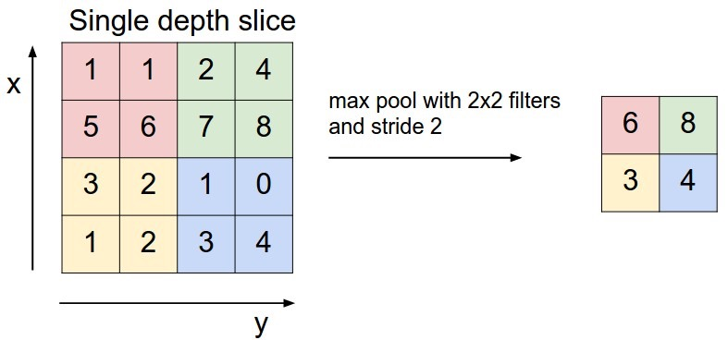
Pooling
Another useful tool for ConvNets are pooling layers.
The most common type of pooling is max pooling.
Notes:
We take the maximum value over a region and only return that value.
INcreases field fo view for later layers, if we simply increased the size of the kernel then we would explode the number of parameters.
Typically pooling layers are put after every single/couple of convolution layers.
One intuition about why pooling is important is that it forces a type of spatial invariance. It also scales the image down so that sub sequential convolution layers will be looking for bigger features in the image.
They are useful to reduce the size of your input parameters and control model overfitting.
Once a useful feature has been identified (edges of certain orientations) we shouldn’t care exactly where they are. They are important at all positions. Other features might be important in terms of their locations relative to other features, not their exact locations.
If we do max pooling over a region of 4 activations we are essentially throwing away 75% of those activations. So they also force some sparsity, which could help with overfitting and generalization.

Slide 35
Convolutional Neural Networks with TF

Slide 36
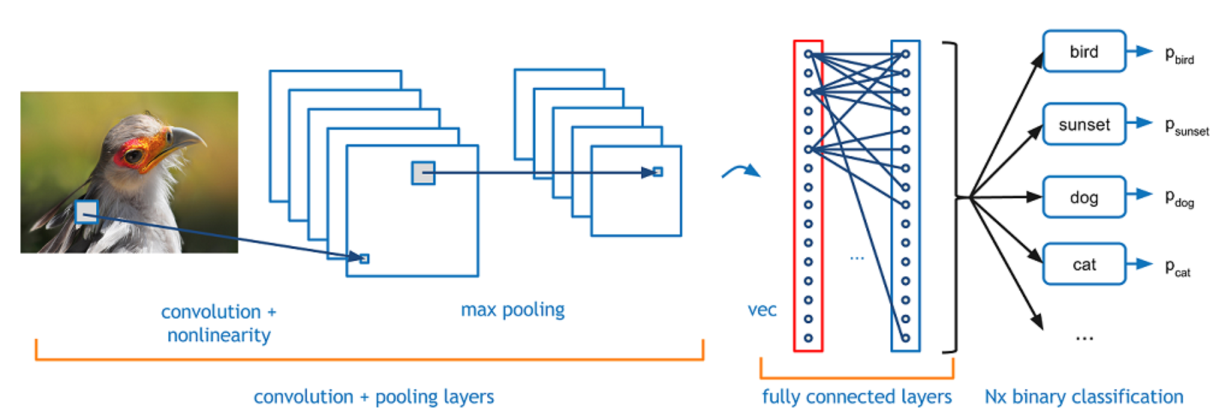
ConvNets with TF
Once again we’ll create generic functions to be used to construct the various layers in our convolutional neural network.

Slide 37
ConvNets with TF - Convolutional Layer
def conv_layer(X, in_channels, n_kernels, kernel_size,
name, activation=None):
with tf.name_scope(name):
init = tf.truncated_normal((kernel_size, kernel_size,
in_dims, n_kernels), stddev=0.1)
W = tf.Variable(init, name=”kernel_weights”)
b = tf.Variable(tf.zeros([n_kernels]), name=”bias”)
z = tf.nn.conv2d(X, W, strides=[1,1,1,1], padding=”SAME”) + b
if activation is not None:
return activation(z)
else:
return z

Slide 38
ConvNets with TF - Pooling Layer
def max_pool(X, pool_size, name):
with tf.name_scope(name):
return tf.nn.max_pool(X, ksize=[1, pool_size, pool_size, 1],
strides=[1,pool_size, pool_size, 1],
padding=”SAME”)

Slide 39
ConvNets with TF - building the network
With tf.name_scope(“cnn”):
conv_1 = conv_layer(X, in_dims=3, n_kernels=32, kernel_size=5,
name=”conv_1”, activation=tf.nn.relu)
pool_1 = max_pool(conv_1, pool_size=2, name=”pool_1”)
flat = tf.reshape(pool_1, [-1, sz_feature_map_x*sz_feature_map_y*32])
dense = dense_layer(flat, n_inputs=sz_feature_map_x*sz_feature_map_y*32,
n_units=32, name=”dense1”, activation=tf.nn.relu)
y_hat = dense_layer(dense, n_inputs=32, n_units=1, name=”output”)
Notes:
Input dims is 3 for rgb images.
Need to flatten image to feed into dense layer, because it expects a vector. Image will be half of the size of the original because of the maxpool, and it will have 32 channels because of the 32 kernels in the convolutional layer.

